Slide 1
Me-No- -Pause
Dr Leila Frodsham
Consultant Gynaecologist, BMS accredited Menopause Specialist
Psychosexual Medicine Lead, Schwartz round co lead,
Foundation Training Programme Director, GSTT
TTF1 module lead, Women’s Health Block co Lead, Stage 3, MBBS, KCL

Slide 2
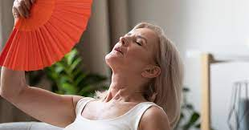
Introduction
What is peri v menopause?
Menopause in the workplace
Symptoms
Menopausal Hormone therapy
Risk v benefit
Systemic
Genital syndrome of Menopause
Alternative treatments

Slide 3
1/3 of women who consulted their GP about menopausal symptoms were not offered HRT
The average woman spends a third of her life post-menopausal
WHY?
50%
of women had not consulted a healthcare professional
¾ of women said that the menopause had caused them to change their lives. 50% felt it had an adverse affect
45%
of women say the menopause has affected their work
51%
of women say that the menopause has affected their sex lives

Slide 4
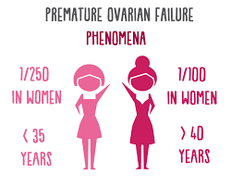
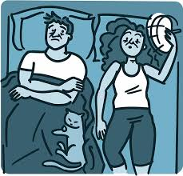
Definitions
Menopause
Retrospective-LAST menstrual period
Average age 51
Early 40-45
Premature <40
Perimenopause
From symptoms to menopause (can be 10 years)
Postmenopause
12 months since the last period
Bleeding after this warrants investigation

Slide 5
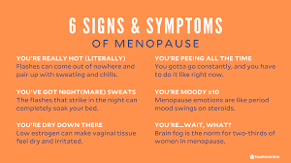
Symptoms
Insomnia, irritability, anxiety
Poor concentration
Brain fog
Headaches
Palpitations
Joint pains
Fatigue
Memory loss
Dysuria
Vaginal dryness, dyspareunia, vaginal irritation, discharge
Heavy, irregular bleeding, flooding, clots
Loss of libido
25% will have no vasomotor symptoms/flushes

Slide 6
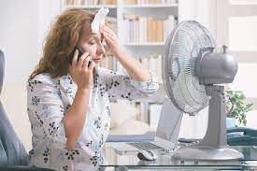
Menopause in the workplace
8/10 menopausal women are working
At least ¾ symptoms-1/4 severe
1/3 of workforce >50
¼ women consider leaving their jobs in the perimenopause
Most women feel inhibited about discussing menopause

Slide 7
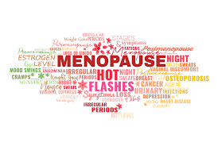
Menopause in the workplace
How to improve things;
Make menopause an open conversation (in appraisal and generally)
Be aware of symptoms and how they affect work
Consider flexible working (to combat sleep issues)
Ventilation and temperature control in the office/
workspaces

Slide 8
Doctors and Menopause
BMA study August 2020:
93% of survey respondents had experienced symptoms as a result of the menopause, with 65% experiencing both physical and mental symptoms.
90% said that these symptoms had impacted their working lives, with 38% saying that the impact was significant.
36% of respondents had made changes to their working lives as a result of menopause and 9% intended to make changes.
38% wanted to make changes to their working lives as a result of menopause but said they were not able to.
Only 16% had discussed their menopause symptoms with their manager and 47% wanted to but did not feel comfortable doing so.

Slide 9
Nearly everyone can have HRT….
Very few absolute contraindications:
Some cancers
Current heart disease
Some liver conditions

Slide 10
Causes of Death - Perception
Mosca et al 2000 @Gynae Expert

Slide 11
Causes of Death - Reality
Anderson 2001 @GynaeExpert

Slide 12
Risks of breast cancer?
WHI study
https://www.whi.org/SitePages/WHI%20Home.aspx
Million Women study
http://www.millionwomenstudy.org/introduction/
Lancet meta analysis August 2019
https://www.thelancet.com/journals/lancet/article/PIIS0140-6736(19)31709-X/fulltext
RCOG/BMS response
https://www.rcog.org.uk/en/newsrcog/-bms-response-to-lancet-study/

Slide 13
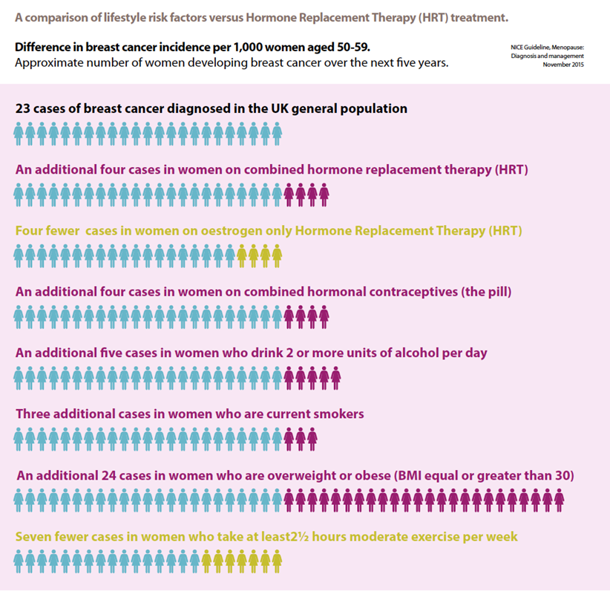

Slide 14
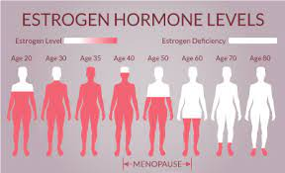
What is HRT?
Oestrogen
Feel good/better concentration
Redistribution of body fat-less tummy
Reduces sweats
Progesterone/progestogens
Protects the womb from cancer but can increase breast cancer (If synthetic)
Can cause bloating and low mood
Testosterone
Increased drive/muscle mass BODY IDENTICAL BEST

Slide 15
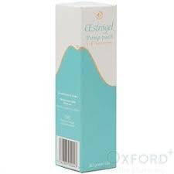
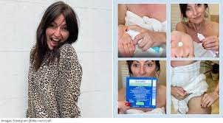
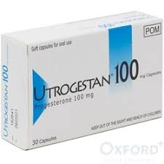
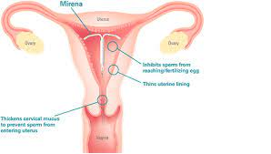
Systemic HRT

Slide 16
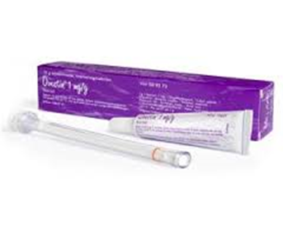
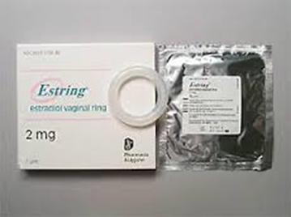
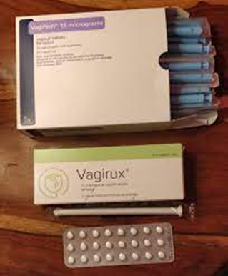
Topical Vaginal Hormones

Slide 17
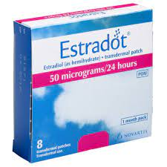
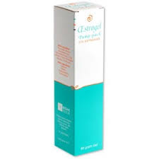
OESTROGEN
Transdermal preparations are safer
No increased risk cancer (<5 yrs)
No Increased risk blood clot

Slide 18
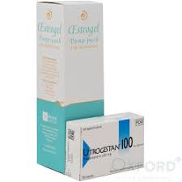
Progestogen/Progesterone
All women with a womb need a progestogen
Side effects
Bloating
Low mood
Less side effects and lower Risk with Progesterone
UTROGESTAN

Slide 19
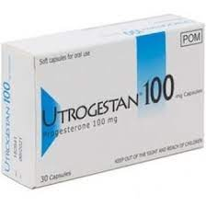
Utrogestan (micronised progesterone)
Neutral risk Breast Cancer (5 years)
Helps sleep
Sequential: 200mg (at night) for 14 days of each month (if still having periods or stopped recently)
Continuous Combined: 100mg (at night)
Can use vaginally if side effects
OR
Mirena IUS- 5 years only

Slide 20
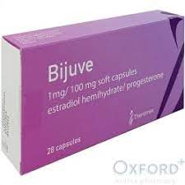
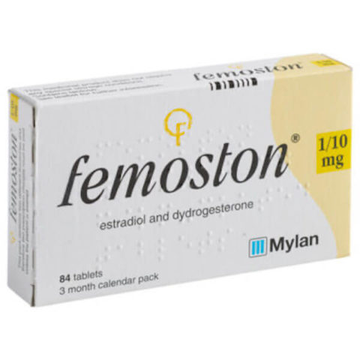
Progesterone/Progestagens
Increase dose if >100mcg patch/4 pumps/Sprays
From 100-200mg or 200mg-300mg
Utrogestan Neutral risk breast cancer (5 years data)
Can be used PV-same dose as tablets
Double dose if bleeding uncontrolled
Mirena-only licensed IUS for EP
Desogestrol lower risk of VTE than NET/Provera

Slide 21
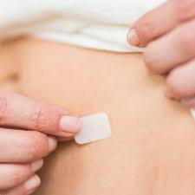
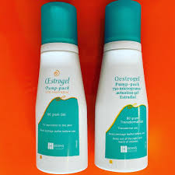
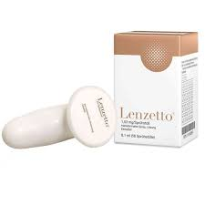
HRT shortages & updates
British Menopause society has regular updates; www.bms.org.uk
Conversion
2 pumps gel= 50mcg patch=3 sprays Lenzetto
Progestagens
Over 100mcg patch/4 pumps gel needs either Mirena or Double Prog
Lenzetto
Apply to inner thigh-NOT ARM-as better absorption and less mastalgia

Slide 22
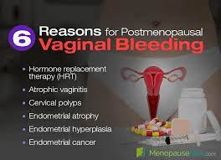
Bleeding on HRT
Bleeding up to 6 months from starting or changing HRT doesn’t require investigation
Women with BMI over 30 should be considered for Mirena
Probability of EC with PMB no HRT-10%
<3mm 0.6-0.8%
>3mm 20-22%
On HRT <1%
If ET (scan) <5mm 0.1-0.2%
If ET >5mm 2-5%

Slide 23
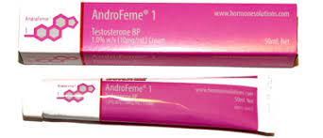
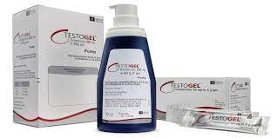
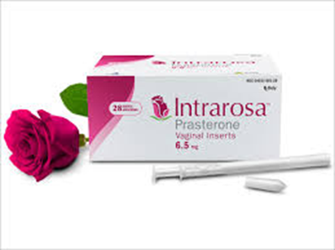
Androgens
Testosterone

Slide 24
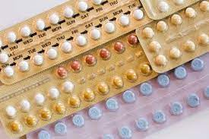
CONTRACEPTION
Need contraception until age 55
HRT is not contraceptive
Mirena-IUS
Contraception and progestogen in HRT
Combined pill can be used until aged 50
contraception, symptoms, bone protection

Slide 25
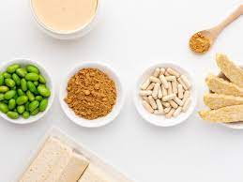
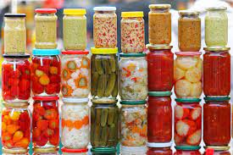
NON HORMONAL TREATMENTS
Diet and lifestyle:
Smoking, alcohol, caffeine, exercise, BMI, fermented foods
Herbal:
Phyto-oestrogens, black cohosh, St John’s Wort
Hot flushes:
Venlafaxine, gabapentin, clonidine, oxybutynin
CBT:
Sleep and hot flushes
https://www.womens-health-concern.org/help-and-advice/factsheets/cognitive-behaviour-therapy-cbt-menopausal-symptoms/
No place for plant based ‘bioidentical’ hormones

Slide 26
NATURAL MENOPAUSE Anne Henderson
Published by Dorling Kindersley
March 2021 – available on Amazon in hardback and audiobook
Holistic approach to peri-menopause and menopause

Slide 27
VVA/Genital Syndrome of Menopause
Prevalence
Symptoms & signs
Treatment
Cases

Slide 28
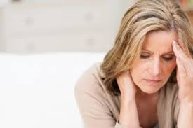
Prevalence
Commonly unrecognised by clinicians
Commonly unrecognised by women & partners
Affects >50% of post reproductive women
66% don’t disclose to menopause specialists
BMS

Slide 29
Symptoms
Vaginal dryness and itching
Discharge
Reduced lubrication
Dyspareunia
Reduced libido
Reduced orgasmic potential
Increasing overactive bladder symptoms
Ask about leakage at orgasm/nocturia
Reduced Quality of life

Slide 30
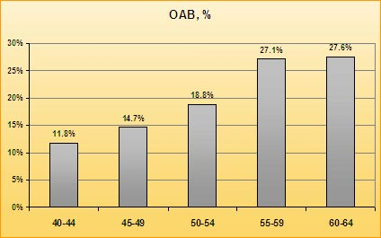
BMS October 2014
Notes:
30

Slide 31
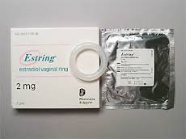
Topical Oestrogens
Img systemic absorption per annum
Hyperplasia as common as in PM women Controls)
No need for Progestogenic cover
Tablet
25mcg-greatest improvement-5-10pg/ml
10mcg-<5pg/ml (70% effective)
Cream
oestriol-less potent
Ring
Similar efficacy-ease of use

Slide 32
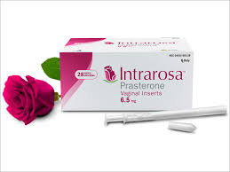
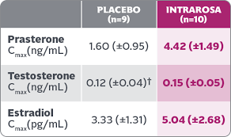
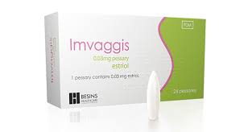
New developments
Prasterone-Interosa
Vagirux
IMVaggis
Laser therapy
-US FDA alert
-Limited evidence to support

Slide 33
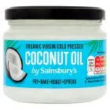
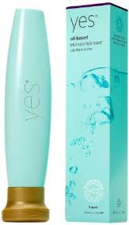
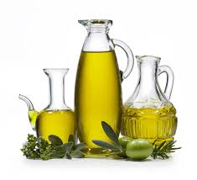
Non hormonal treatments
Water based remoisturisers
WB Yes-on prescription-high osmolality
Lubricants
Oil based ‘Yes’
Coconut oil
Daily massage and stretch

Slide 34
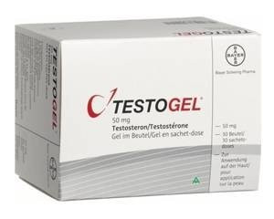
Orgasmic Function
Ensure adequate Oestrogen-Systemic and topical
Reduced libido
Reduced orgasmic function

Slide 35
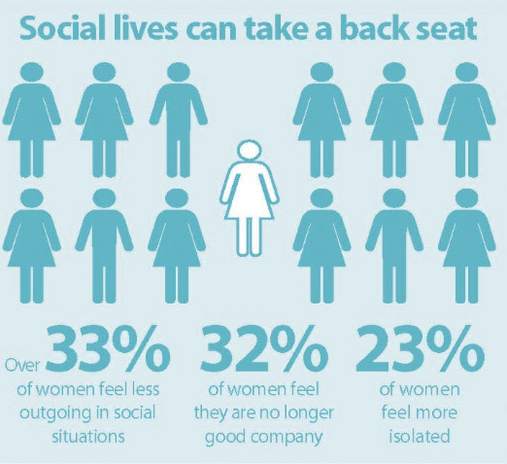
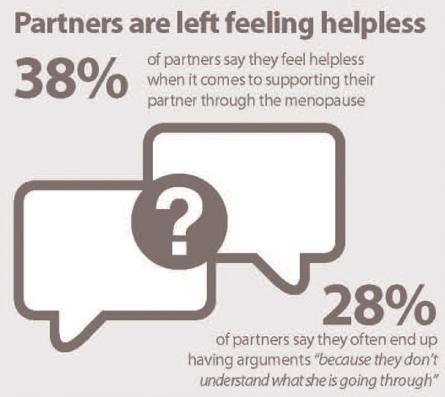
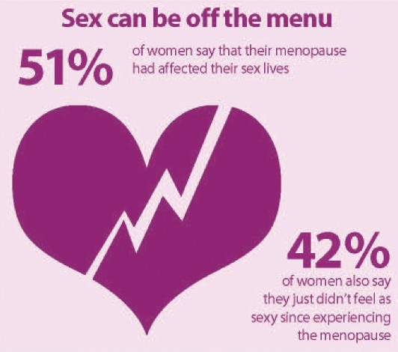
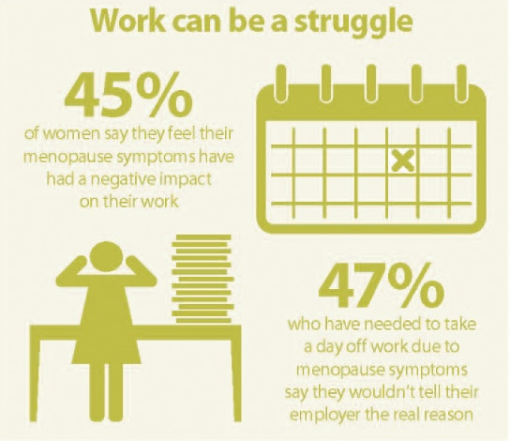
Menopause and partners
Data from the British Menopause Society highlights that the menopause is an issue for relationships, and work
Menopause is relevant to everyone

Slide 36
Experiences of menopause are not the same
Queermenopause.com
Supporting transmen, non-binary and intersex people through menopause
And throughout the LGBTQ+ community
https://linktr.ee/blackwomeninmenopause
Resources and information
Support groups e.g. facebook group
Daisynetwork.org
Supporting those with Premature Menopause

Slide 37
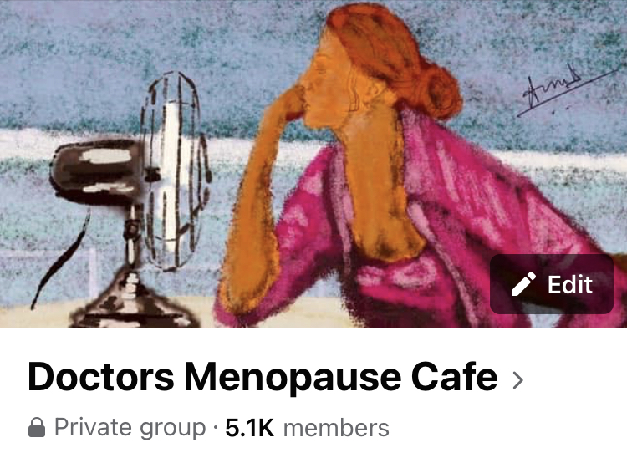
Doctor’s Menopause Cafe
Perfect storm-Covid and BMA survey
Furious women denied care on Twitter
Exhausted GP’s unable to provide care and desperate for help
Need for accessible education
Collaboration between Karen Edwards (ED consultant)
and me-BMS specialist
5 moderators- Run DMC
Now 5.1k members and winner of first prize at BMS ASM!

Slide 38
Menopause cafe
For everyone-online
Produce resources for the workplace

Slide 39
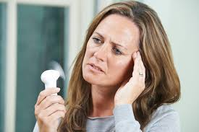
RESOURCES
www.menopauseandme.co.uk
British Menopause Society
www.menopausematters.co.uk
www.Queermenopause.com
www.Daisynetwork.org
Louise Newson: www.balance-menopause.com

Slide 40
Questions?

