Slide 1
NHS Bexley
Talking Therapies

Slide 2
THE MENOPAUSE
Topic not mentioned before
Today it is more spoken about and accepted
Many experience uncertainty on how to deal with this stage
Uncertainty can lead to feelings of worry, low mood, anxiety and panic

Slide 3
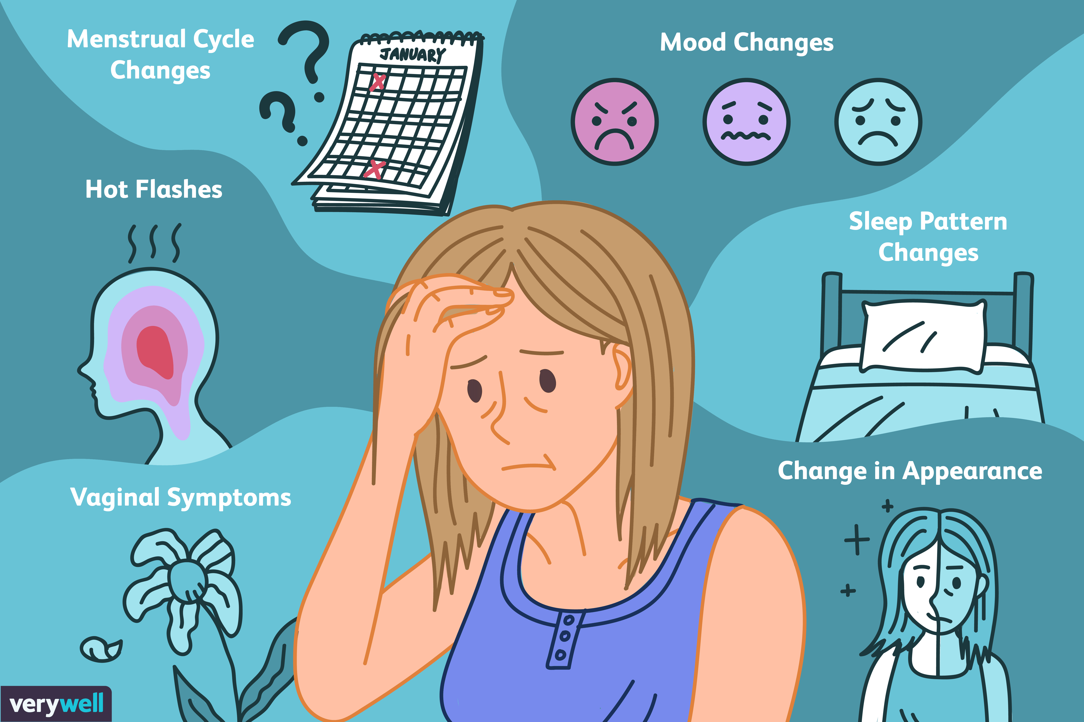
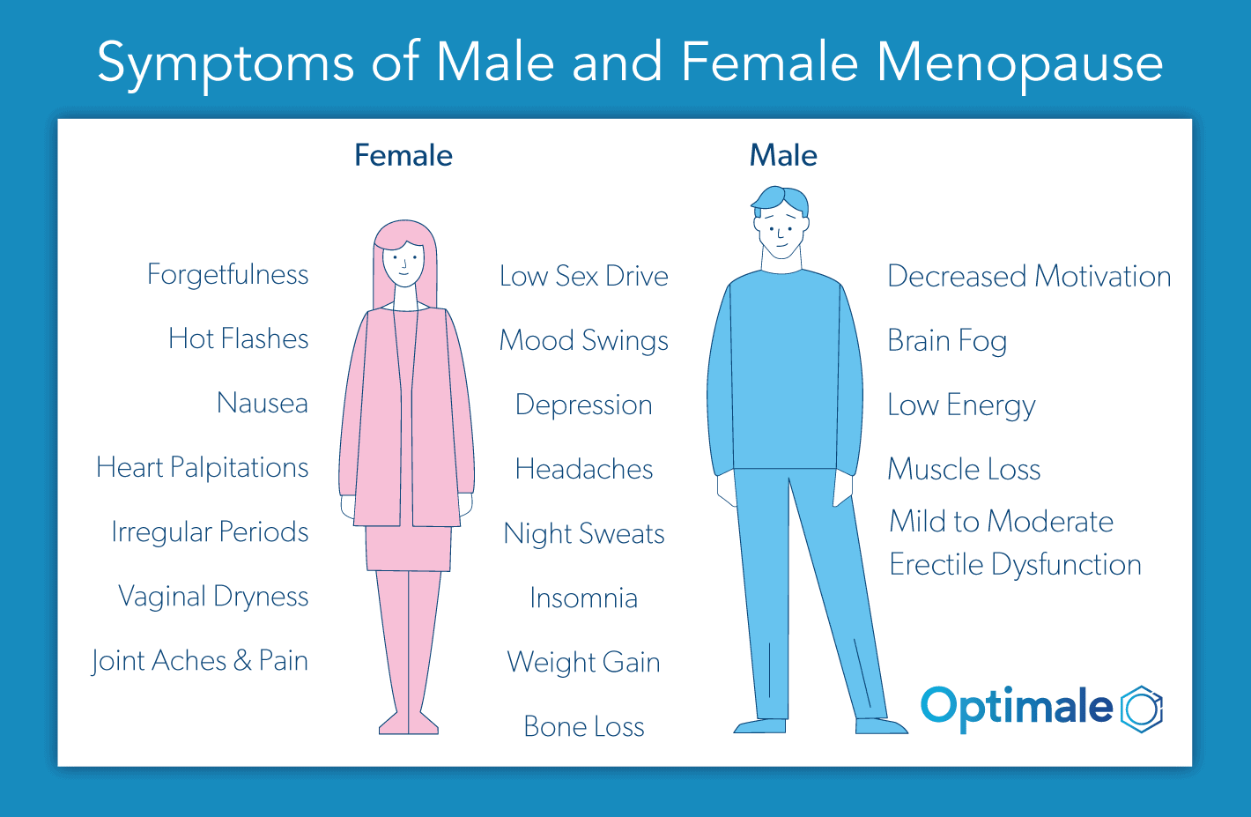
Symptoms
Sudden changes in mood
Hot flushes
Weight gain
Loss of energy
Brain fog or forgetfulness
Difficulty Sleeping
Changes in skin or hair condition
No symptoms at all

Slide 4
Coping with Menopause
Everyone copes in a different way
Support from family and friends
Visit GP
Medication
Alternative therapies

Slide 5
How we can help
Refer in
Assessment (60-90 minutes)
Online CCBT at your own pace
Guided Self Help over the telephone
One to one Cognitive Behavior Therapy ( online or face to face)
One to one Counselling ( online or face to face)
Group Interventions

Slide 6
Minding stories of Menopause
We are keen to work with residents to capture and record experiences and perceptions and explore the impact on wellbeing of this important life stage which is often absent in narrative research.
We will recruited co-researchers from the Bexley community who will receive training and support in oral history interviewing techniques to help us record women’s accounts.
The collection will be exhibited throughout the Borough to help raise awareness and will offer an accessible resource for residents, health care professionals and researchers.
For further information please email Dr D. Palmer (PhD) dpalmer@mindinbexley.org.uk

Slide 7
Recovery Services

Slide 8
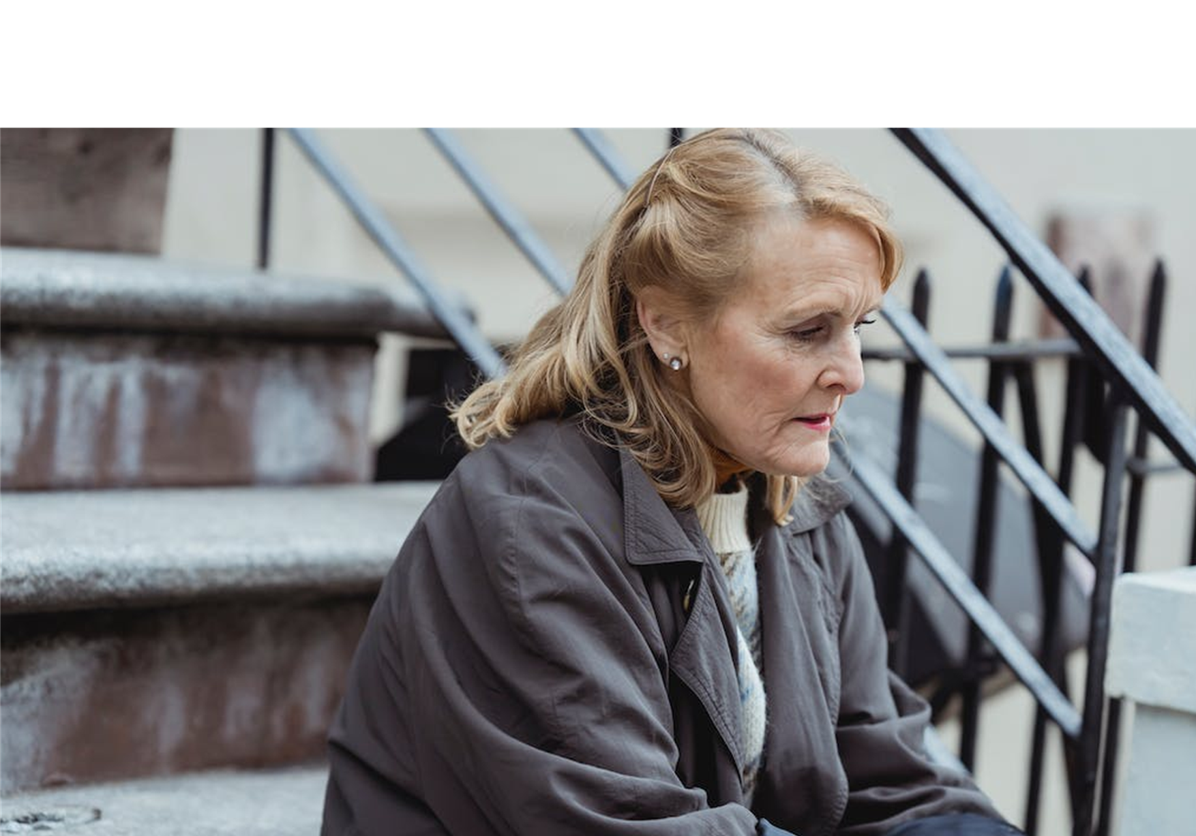
Mind in Bexley Recovery Services
Mind in Bexley’s Recovery Service enables personal recovery for people struggling with their mental health.
The service offers a range of support including managing the impact of mental ill-health, managing stress, anxiety and depression, improving wellbeing, exploring money management, finding and/or retaining employment and support groups for managing the menopause.
www.mindinbexley.org.uk/recovery recovery@mindinbexley.org.uk 020 8303 8932 (Option 2)

Slide 9
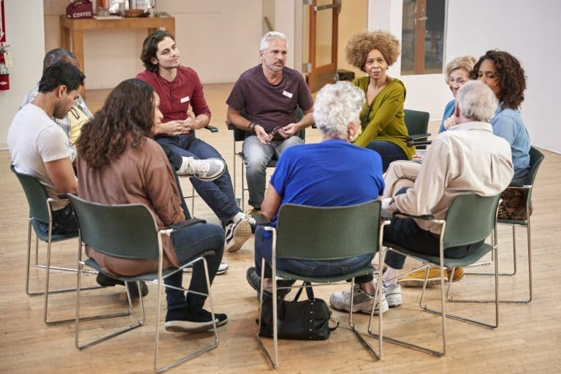
Recovery Services Menopause Support
Peer Support Groups
Choice of different times
Drop in and attend when you can
Informal setting

Slide 10
Mind in Bexley Crisis Café
The Bexley Crisis Café is open every evening for support in a crisis.
It is a safe space to talk to our mental health experts face-to-face. We will listen, support and signpost you to relevant local services.
Open 6pm to 10pm, seven days a week
2a Devonshire Road
Bexleyheath DA6 8DS
www.mindinbexley.org.uk/crisis-cafe

Slide 11
TALK TO US
Call Mind in Bexley on 0208 303 8932 option 1
or ask your GP or Healthcare Professional for a referral
or refer online at: mindinbexley.org.uk or email: referral@mindinbexley.org.uk
Mind in Bexley
2A Devonshire Road, Bexleyheath DA6 8DS

