Slide 1
The cycle or stages of change
Everyone who makes a change will go through certain stages (outlined below)
Pre-contemplation: We aren’t even thinking about changing (even though some other people may think that we should change)
Contemplation: We begin to think about perhaps changing, but at the same time, we think maybe not (sometimes called ambivalence, or being in two minds about change)
Preparation: Here we start to prepare to make a change (maybe asking others how to go about it when we decide to do it)
Action: Here we start to do the changing, rather than just thinking or asking about it (sometimes called walking the walk)
Maintenance At this stage we carry on with the changes made during action (the longer we do this, the more familiar it becomes, although we need to stay vigilant)
Relapse or recurrence Many people will have a setback and return to the behaviour that they changed (many people go through this stage, but will soon get back to contemplation or action)

Slide 2
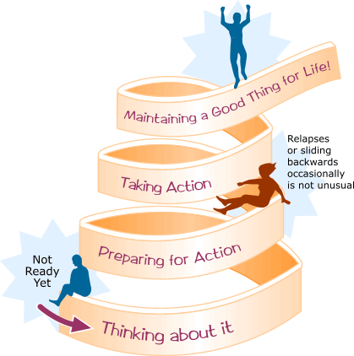
The stages or cycle of Change

